Slide 1

TRAINING WORKSHOP
NCDC, Abuja
12-16th Feb 2024

Slide 2
Who are we?
Kirstyn Brunker
Criselda Bautista
Martha Luka
Kathryn Campbell
Sandeep Kasaragod
Smitha Abraham
Notes:
Creeping death

Slide 3

Workshop etiquette
Treat each other with respect
General lab rules apply
Turn off your cellphones
For demonstrator attention: raise a hand
Participants can ask questions at any time following a raised hand
Everyone may take a moment to step out of the room discreetly without explanation at any time

Slide 4
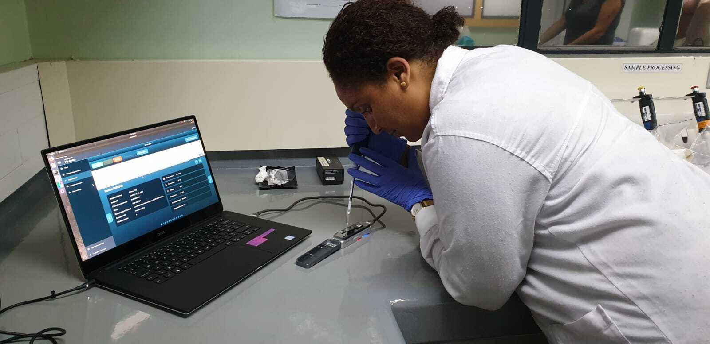
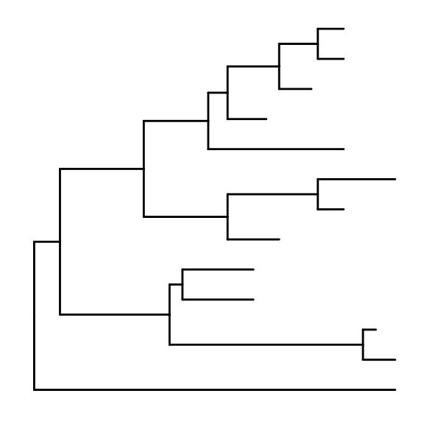
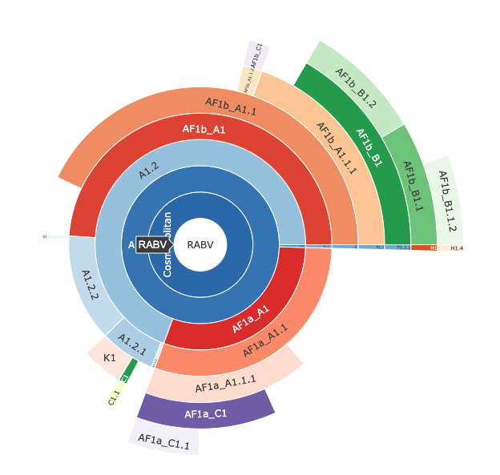
Workshop content
An introduction to genomic surveillance for rabies virus
Wet lab
Sequencing library preparation
Nanopore sequencing
Monitoring the run
Dry lab
Processing raw data
Building trees
Visualising & interpreting your data

Slide 5
Bautista et al., JoVE

Slide 6
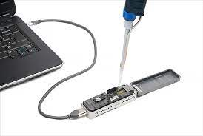
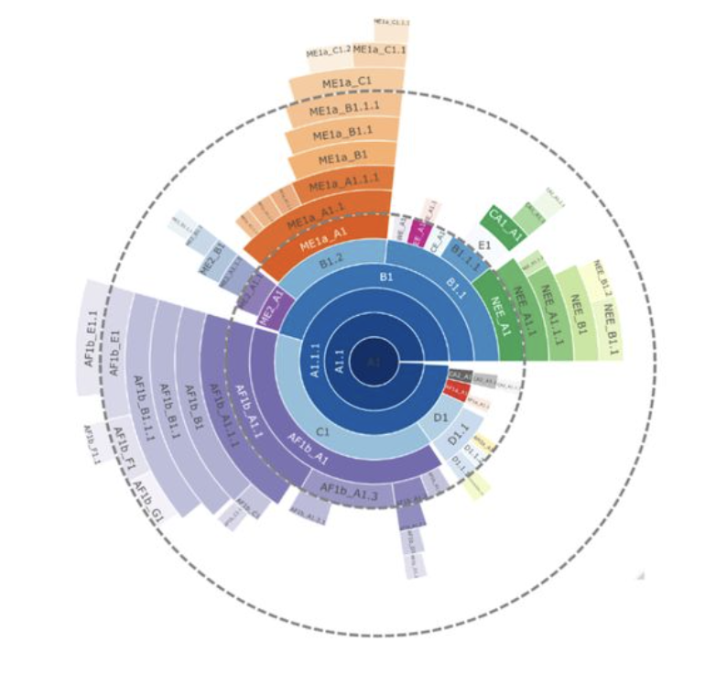

Schedule
MONDAY | TUESDAY | WEDNESDAY | THURSDAY | FRIDAY
OPENING WET LAB STARTER | WET LAB | WET LAB/DRY LAB | DRY LAB | DRY LAB
Background & lab intro | Masterclasses & Nanopore library prep I | Nanopore library prep II & sequencing Intro to Bioinformatics | Bioinformatics pipeline Alignments & Phylogenies | Advanced analysis, interpretation & visualisation

Slide 7

Intended learning outcomes
An understanding of an end-to-end workflow for sequencing rabies virus
Background theoretical knowledge
Mastering key techniques
How to apply ”light-touch” analytical tools

Slide 8
Who are you?

Slide 9
Introductions (1min each)
Introduce yourself (name, position, where you are from)
What is your past experience (if any) with sequencing?
What are you hoping to gain from the workshop?

